Slide 1

Data Structure & Algorithms
By- Chandana MN
Rupa Shravya
Ankitha VP
Divyashree
Akshita
Assigned by-Prof. Anoop Kumar Srivastava

Slide 2
BFS and DFS

Slide 3
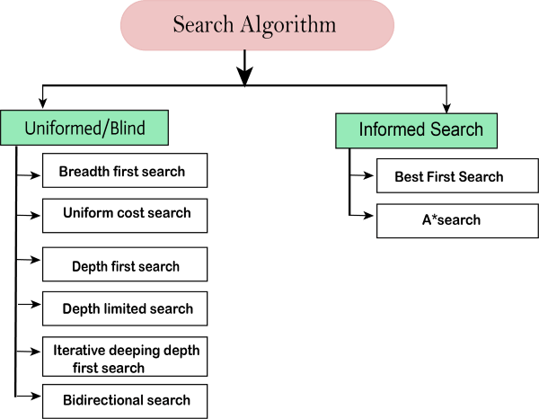
Types of search algorithm

Slide 4
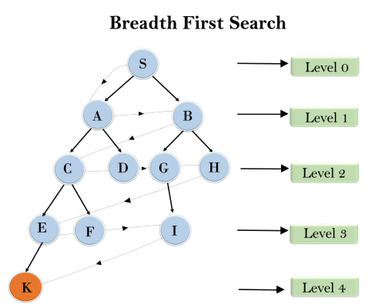
BFS
Bfs- breadth first search
Breadth first search is the most common search strategy for traversing a tree or graph. This algorithm searches breadth wise in a tree or graph, so it is called breadth-first search.
BFS algorithm starts searching from the root node of the tree and expands all success or node at the current level before moving to nodes of next level
The breadth-first search algorithm is an example of a general-graph search algorithm.
Breadth-first search implemented using FIFO queue data structure.

Slide 5
Breadth-First Search Algorithm Pseudocode
Input: s as the source node
BFS (G, s)
let Q be queue.
Q.enqueue( s )
mark s as visited
while ( Q is not empty)
v = Q.dequeue( )
for all neighbors w of v in Graph G
if w is not visited
Q.enqueue( w )
mark w as visited

Slide 6
Advantages and Disadvantages of BFS
Advantages:
BFS will provide a solution if any solution exists.
If there are more than one solutions for a given problem, then BFS will provide the minimal solution which requires the least number of steps.
Disadvantages:
It requires lots of memory since each level of the tree must be saved into memory to expand the next level.
BFS needs lots of time if the solution is far away from the root node.

Slide 7
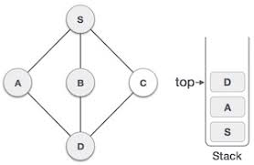
DFS
DFS-depth first search
Depth-first search is recursive algorithm for traversing a tree or graph data structure.
It is called the depth-first search because it starts from the root node and follow seach path to its greatest depth node before moving to the next path.
The algorithm starts at a node of a graph and goes as far as possible in a given path, then backtracks until it finds an unexplored path, and then explores the rest of it. The process is repeatedly followed until all the nodes in the graph are explored.
DFS uses a stack data structure for its implementation.
The process of the DFS algorithm is similar to the BFS algorithm.

Slide 8
Depth-First Search Algorithm Pseudocode
init() { For each u ∈ G u.visited = false For each u ∈ G DFS(G, u) }
DFS(G, u) u.visited = true for each v ∈ G.Adj[u] if v.visited == false DFS(G,v)

Slide 9
Advantages and Disadvantages of DFS
Advantages:
DFS requires very less memory as it only needs to store a stack of the nodes on the path from root node to the current node.
It takes less time to reach to the goal node than BFS algorithm (if it traverses in the right path).
Disadvantages:
There is the possibility that many states keep re-occurring ,and there is no guarantee of finding the solution.
DFS algorithm goes for deep down searching and sometimes it may go to the infinite loop.

Slide 10
Differences between BFS and DFS
Sr. No. | Key | BFS | DFS
1 | Definition | BFS, stands for Breadth First Search. | DFS, stands for Depth First Search.
2 | Data structure | BFS uses Queue to find the shortest path. | DFS uses Stack to find the shortest path.
3 | Source | BFS is better when target is closer to Source. | DFS is better when target is far from source.
4 | Suitablity for decision tree | As BFS considers all neighbour so it is not suitable for decision tree used in puzzle games. | DFS is more suitable for decision tree. As with one decision, we need to traverse further to augment the decision. If we reach the conclusion, we won.
5 | Speed | BFS is slower than DFS. | DFS is faster than BFS.
6 | Time Complexity | Time Complexity of BFS = O(V+E) where V is vertices and E is edges. | Time Complexity of DFS is also O(V+E) where V is vertices and E is edges.

Slide 11
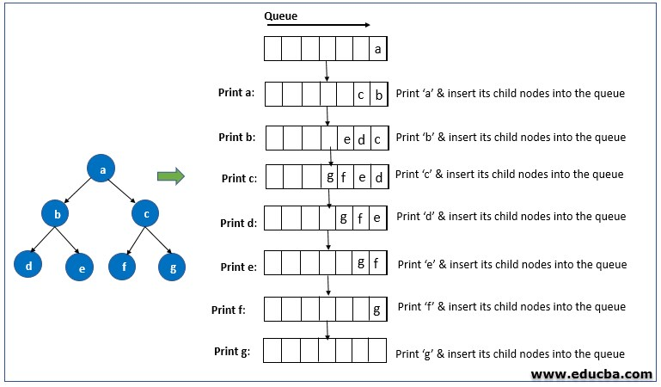

Problems:
Problem on BFS

Slide 12
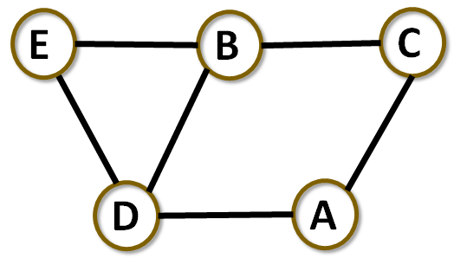
Problem on BFS

Slide 13
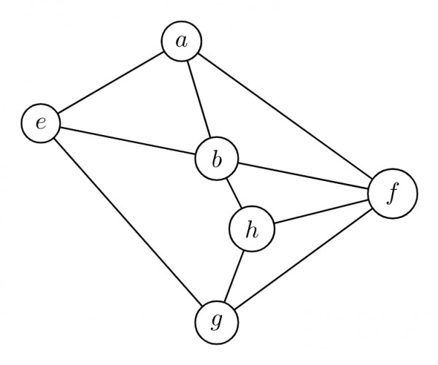
Problem on DFS
Among the following sequences:
(I) a b e g h f
(II) a b f e h g
(III) a b f h g e
(IV) a f g h b e
Which is not the depth first traversals of the above graph?

Slide 14
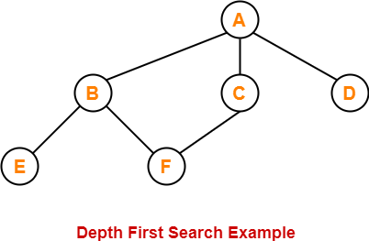
Problem on DFS

Slide 15


